Slide 1
Mathematical Properties of Binary Trees

Slide 2
Properties of Binary Tree
Property:
A binary tree with N internal nodes has N+1 external nodes.

Slide 3

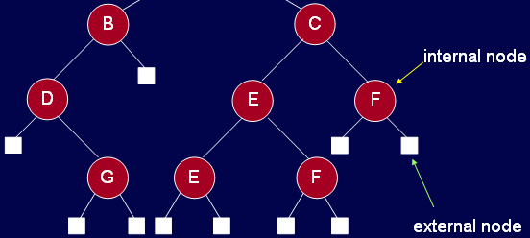
Properties of Binary Tree
A binary tree with N internal nodes has N+1 external nodes.
internal nodes: 9
external nodes: 10

Slide 4
Properties of Binary Tree
Property:
A binary tree with N internal nodes has 2N links: N-1 links to internal nodes and N+1 links to external nodes.

Slide 5
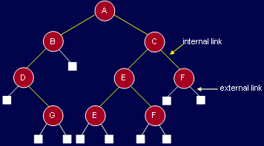
Properties of Binary Tree
Internal links: 8
External links: 10

Slide 6
Properties of Binary Tree
  Property: A binary tree with N internal nodes has 2N links: N -1 links to internal nodes and N+1 links to external nodes.
    In every rooted tree, each node, except the root, has a unique parent.
    Every link connects a node to its parent, so there are N -1 links connecting internal nodes.
    Similarly, each of the N +1 external nodes has one link to its parent.
    Thus N -1+N +1=2N links.
Notes:
Proof

Slide 7
Threaded Binary Tree
In many applications binary tree traversals are carried out repeatedly.
The overhead of stack operations during recursive calls can be costly.
The same would true if we use a non-recursive but stack-driven traversal procedure.
It would be useful to modify the tree data structure which represents the binary tree so as to speed up, say, the inorder traversal process: make it "stack-free”.
Notes:
Suppose that we have a BST that is traversed again and again for some operations of find or print. Due to lot of recursive operations, the stack size keeps on growing.
As a result, the performance is affected. To overcome this performance bottleneck, we can use non-recursive method, but stack-driven traversal will again be an issue.
The push and pop operations of stack for insertion and retrieval will again take time.
So is there a way to do traversal without using a stack (Stack free execution).

Slide 8
Threaded Binary Tree
Oddly, most of the pointer fields in our representation of binary trees are NULL!.
Since every node (except the root) is pointed to, there are only N-1 non-NULL pointers out of a possible 2N (for an N node tree), so that N+1 pointers are NULL.
Notes:
Leaf node has left and right pointer null. Think about to add new node ( only add data and pointer are NULL by default). Only to know leaf node true these two pointers if they are NULL.
We are creating a new data structure inside the tree and when the tree will be constructed, it will be called a threaded binary tree. The NULL pointers are replaced
by the inorder successor or predecessor. That means while visiting a node, we can tell which nodes will be printed before and after that node.

Slide 9
Threaded Binary Tree
Internal links: 8
External links: 10
Notes:
Each recursive function call consumes a portion of the stack memory. If the tree is too deep (e.g., in the case of a skewed tree, which resembles a linked list), you could exhaust the call stack and encounter a stack overflow.
Example: A binary tree with 1,000,000 nodes could result in a stack overflow if the recursion goes too deep without optimization..
roblem: Recursive functions can lead to performance overhead due to repeated function calls and the overhead of maintaining the call stack.
This threading eliminates the need for a stack or recursion in certain tree traversal operations, making them more efficient.

Slide 10
Threaded Binary Tree
The threaded tree data structure will replace these NULL pointers with pointers to the inorder successor (predecessor) of a node as appropriate.
We'll need to know whenever formerly NULL pointers have been replaced by non NULL pointers to successor/predecessor nodes, since otherwise there's no way to distinguish those pointers from the customary pointers to children.

Slide 11
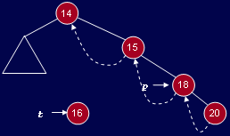
Threaded Binary Tree
T -> L = p -> L; // copy thread
t->LTH = thread;
t->R = p; // *p is successor of *t
t->RTH = thread;
p->L = t; // attach the new leaf
p->LTH = child;
Notes:
This is an important point as we need to modify our previous logic of identifying leaf nodes.
Previously the node with left and right nodes as NULL was considered as the leaf node but after this change the leaf node will contain pointers to predecessor and successor.
So in order to identify that the pointers has been modified to point to their inorder successor and predecessor, two flags will be required in the node.
One flag will be used for successor and other for predecessor. If both the pointers were NULL, left pointer variable will be used to point inorder predecessor,
The flag for this will be turned on and the right pointer variable will be used to keep inorder successor and the flag will be turned on once the successor address is assigned.

Slide 12
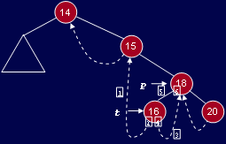
Threaded Binary Tree
1. t->L = p->L; // copy the thread
2. t->LTH = thread;
3. t->R = p; // *p is successor of *t
4. t->RTH = thread;
5. p->L = t; // attach the new leaf
6. p->LTH = child;

Slide 13
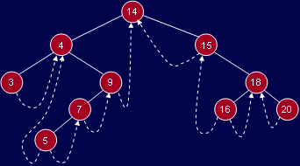
Threaded Binary Tree

Slide 14
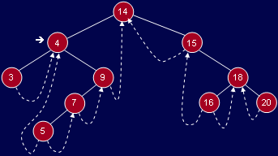
Routine: nextInorder( )
TreeNode* nextInorder(TreeNode* p)
{
if(p->RTH == thread)
return(p->Right);
else
{
p = p->Right;
while(p->LTH == child)
p = p->Left;
return p;
}
}

Slide 15
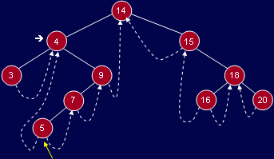
Where is inorder successor?
Inorder successor of 4.
Left-most node in right subtree of 4

Slide 16
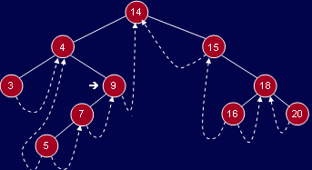
Where is inorder successor?
Inorder successor of 9.
Follow right thread to 14

Slide 17
Inorder traversal
If we can get things started correctly, we can simply call nextInorder repeatedly (in a simple loop) and move rapidly around the tree inorder printing node labels (say) - without a stack.
If we call nextInorder with the root of the binary tree, we're going to have some difficulty. The code won't work at all the way we want.

Slide 18
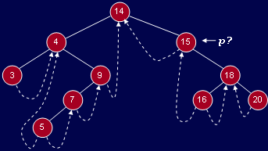
Calling nextInorder with root
TreeNode* nextInorder(TreeNode* p){ // root is 14 here
if(p->RTH == thread) return(p->Right);
else {
p = p->Right;
while(p->LTH == child)
p = p->Left;
return p;
}
}
What is the Problem?

Slide 19
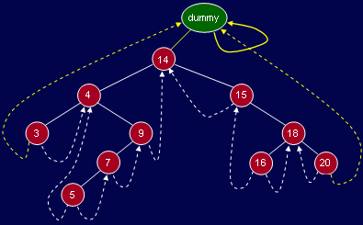
Fix with Dummy Node

Slide 20
Inorder traversal
void fastInorder(TreeNode* p)
{
while( ( p=nexInorder(p) ) != dummy )
cout << p->Info;
}
Start the inorder traversal by calling
fastInorder(dummy)
TreeNode* nextInorder(TreeNode* p)
{
if(p->RTH == thread) return(p->R);
else {
p = p->R;
while(p->LTH == child)
p = p->L;
return p;
}
}

Slide 21
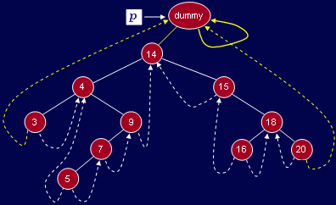
Trace or nextInorder

Slide 22
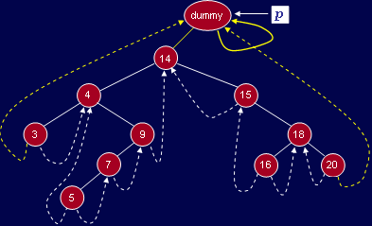
Trace or nextInorder

Slide 23
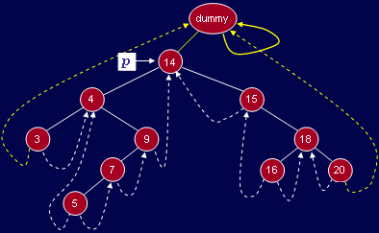
Trace or nextInorder

Slide 24
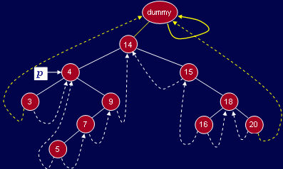
Trace or nextInorder

Slide 25
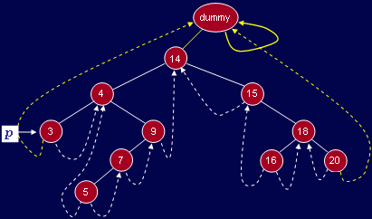
Trace or nextInorder

Slide 26
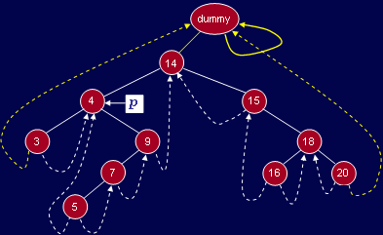
Trace or nextInorder

Slide 27
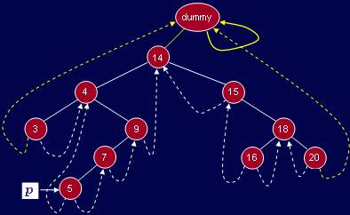
Trace or nextInorder

Slide 28
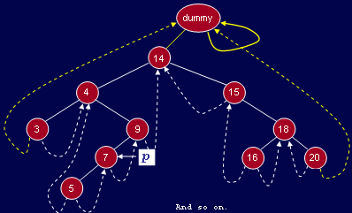
Trace or nextInorder

Slide 29
Thank You …

